Slide 1



Creating a better tomorrow, together!
at JBIET

Slide 2




WELCOME
TO OUR PROJECT
MADE BY
“ TECH TROOPERS”
DEPARTMENT OF (CSM) & (AI&ML)

Slide 3

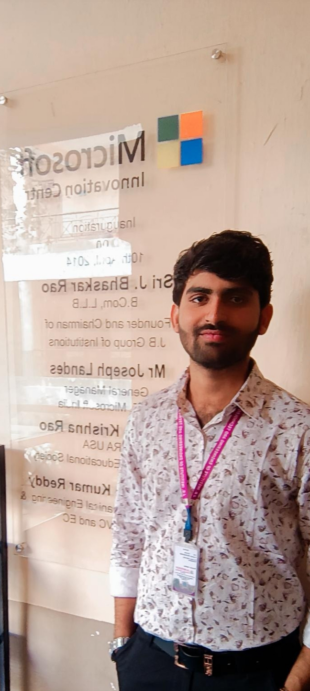

THE TEAM
ARUN
(TEAM LEADER)
ADARSH
YASH

Slide 4





KUMUD
ARCHANA
ANUSHKA

Slide 5




PHISHING
Phishing is a type of cyber attack that uses social engineering techniques to trick individuals into revealing sensitive information, such as passwords or credit card numbers.

Slide 6


NOW A
DAYS
With the significant
growth of internet usage,
people increasingly
share their personal
information online

Slide 7
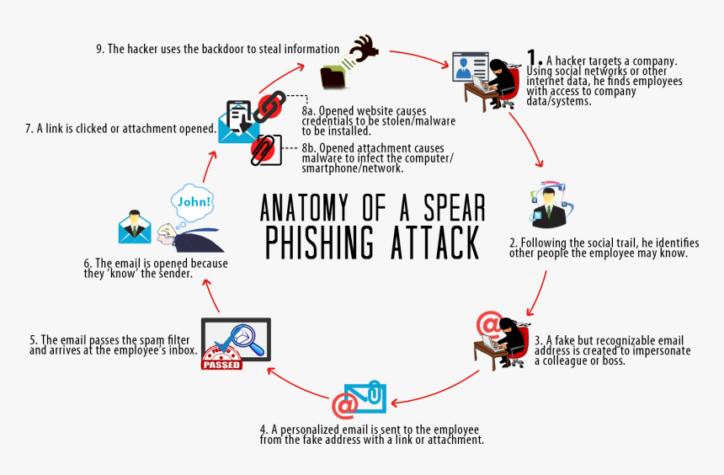


Slide 8


A study (KeepnetLABS, 2018) confirmed that more than 91% of system breaches are caused by attacks initiated by email.

Slide 9
WHAT ATTRIBUTES MAKE SOME PEOPLE MORE
SUSCEPTIBLE TO PHISHING ATTACKS THAN OTHERS
participants with an age range between 18 and 25 are more susceptible to phishing than other age groups.The reason that younger adults are more likely to fall for phishing, is that younger adults are more trusting when it comes to online communication, and are also more likely to click on unsolicited e-mails

Slide 10
QUESTIONS
ask about phishing
1) what is the difference between spam and phishing ?
Spam is electronic junk mail or, more broadly, unsolicited sales emails. Spam differs from phishing because spam emails will not request sensitive or confidential information; rather they will attempt to sell you an item, service, or subscription.

Slide 11
2) What kind of information should I protect?
You should protect all sensitive and confidential data. For information on what is considered sensitive and confidential data,such as
Emails containing private information
Passwords
Personal data (address, social security number, passport number, drivers license number, etc.)
Financial data (credit/debit card number, bank account information)

Slide 12
3) How do I avoid becoming a victim of a phishing scam?
If you receive a request in which you are asked for confidential information, do not reply or click links or attachments.
Remember that neither USC nor ITS will ever request that you submit personal information, including any passwords, over email.

Slide 13
Never provide confidential information or documents through email. Always call or provide this type of information in person, when possible.
If in doubt about an email, call the company/individual directly to verify. Be sure to call the phone number listed publicly online (if applicable). Do not use any phone numbers listed in messages sent to you and further

Slide 14
4) How do I report a phishing email?
Forwarding Emails and Headers from Gmail (Google Apps at USC)
Forwarding Emails and Headers from the Outlook Web App (Microsoft Office 365)
Forwarding Emails from the Outlook Desktop Client (Windows and Mac)

Slide 15
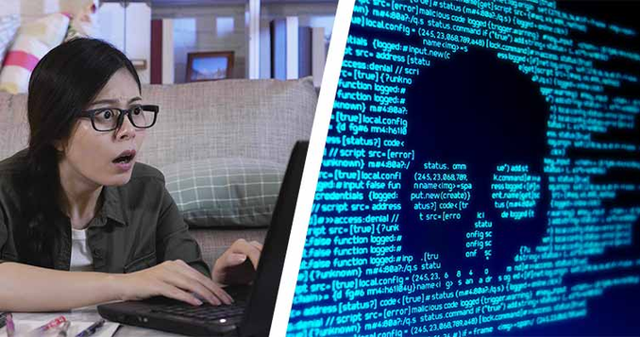
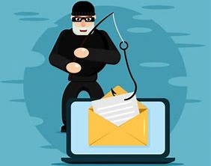


“Don’t be the next victim of cybercrime.”

Slide 16


In a world of bits and bytes, I'm the ultimate hacker.

Slide 17


The Look and Feel of Genuine Domains
Phishing domains are designed to look like legitimate websites, with logos, colors, and layouts that mimic those of the real sites.
They often use similar domain names, such as adding an extra letter or changing a letter to a number, to make it difficult for users to detect the difference. These tactics are used to trick users into providing sensitive information, such as login credentials or credit card numbers.

Slide 18


ITS IMPORTANT TO
1
2
3
Check the URL
carefully
and look for any
misspellings
or unusual
characters.
pay attention to the details when visiting websites, especially when entering sensitive information.
be wary of pop-up
windows or
requests for personal
information.

Slide 19



THE NEED FOR AN INTELLIGENT SYSTEM
Alarming trend highlights the need for a more advanced approach to detecting these threats .
An intelligent system powered by artificial intelligence (AI) and machine learning (ML) can provide the necessary capabilities to combat modern phishing attacks. By analyzing large amounts of data and identifying patterns, an AI-powered system can detect even the most subtle indicators of phishing activity.

Slide 20


HOW AI CAN DETECT PHISHING DOMAINS
Artificial intelligence (AI) has revolutionized the way we detect phishing domains. By analyzing vast amounts of data, AI algorithms can identify patterns and anomalies that are difficult for humans to detect.
This allows us to quickly and accurately identify potential threats and take action before they cause harm.

Slide 21
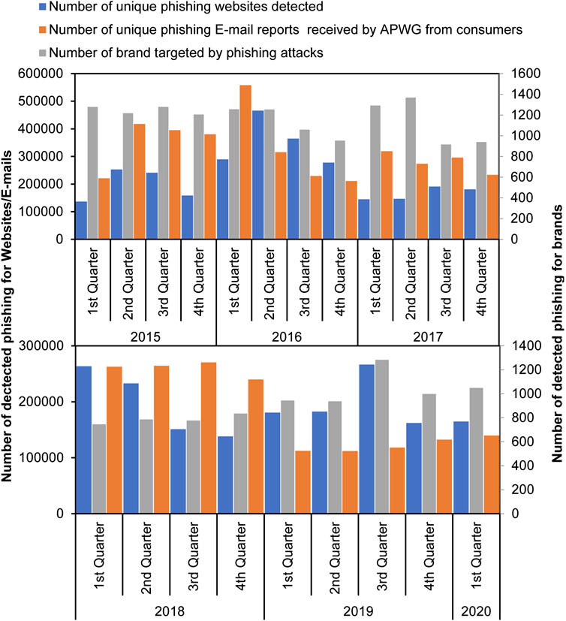


FIGURE SHOWS THE GROWTH IN PHISHING ATTACKS 2015–2020 BY QUARTERS BASED ON DATA COLLECTED FROM APWG ANNUAL REPORTS.

Slide 22
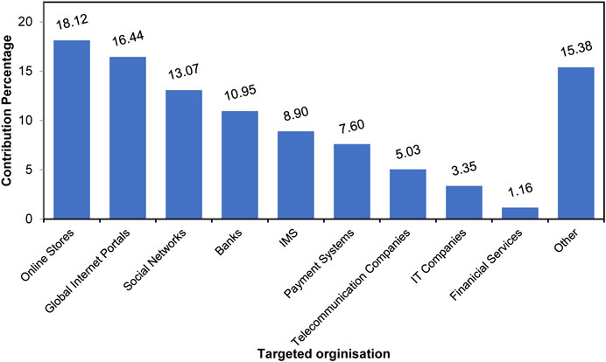
DISTRIBUTION OF ORGANIZATIONS AFFECTED BY PHISHING ATTACKS DETECTED BY KASPERSKY IN QUARTER ONE OF 2020.

Slide 23
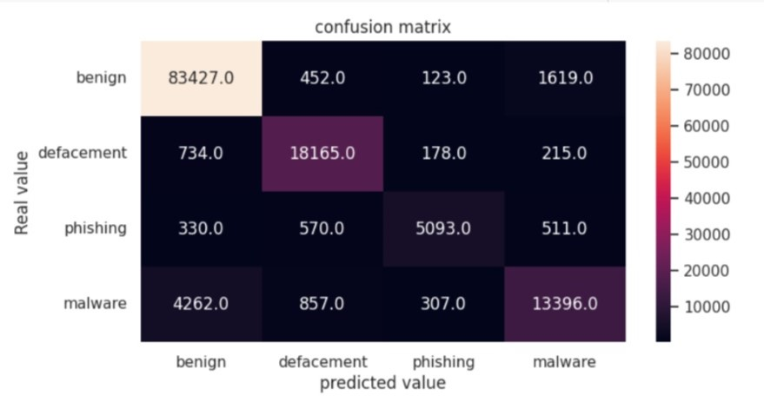


Slide 24
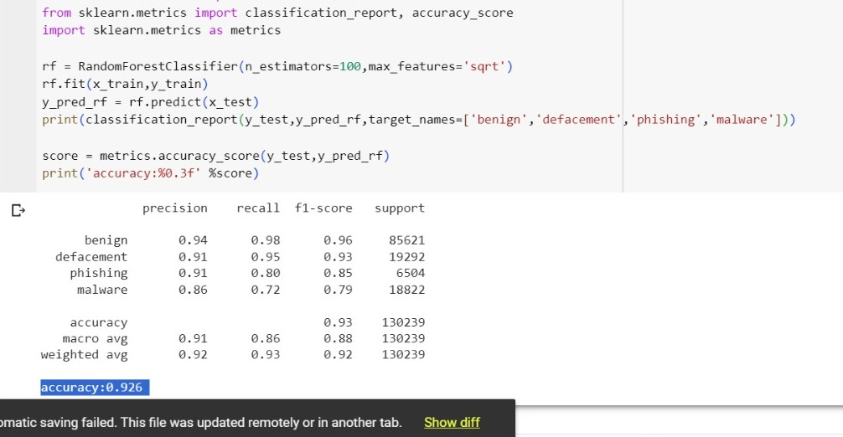

Slide 25













Resource
Page
~ GOogle collab
~PYcharm
~Kaggle

Slide 26

Conclusion
Conclusion 1
Conclusion 2
it is clear that phishing is a serious threat
to individuals and organizations alike.
The ability of phishing domains
to imitate genuine domains
makes them difficult to detect using traditional methods.
By using this technology, we can
significantly reduce the risk of falling
victim to phishing attacks.

Slide 27


THANK YOU
FROM TECH TROOPERS

